Slide 1
Object-Oriented Paradigm
CSCI 4448/5448: Object-Oriented Analysis & Design
Lecture 4

Slide 2
Acknowledgement & Materials Copyright
I’d like to start by acknowledging Dr. Ken Anderson
Ken is a Professor and the Chair of the Department of Computer Science
Ken taught OOAD on several occasions, and has graciously allowed me to use his copyrighted material for this instance of the class
Although I will modify the materials to update and personalize this class, the original materials this class is based on are all copyrighted © Kenneth M. Anderson; the materials are used with his consent; and this use in no way challenges his copyright

Slide 3
Learning Objectives
Introduce some references used for class
Discuss the class experience with OO development
Introduce the object-oriented paradigm
Contrast it with functional decomposition
Discuss important concepts of object-oriented programming
Discuss the difference between abstraction and encapsulation
This is VERY important
Address the problem of requirements and the need to deal with change

Slide 4
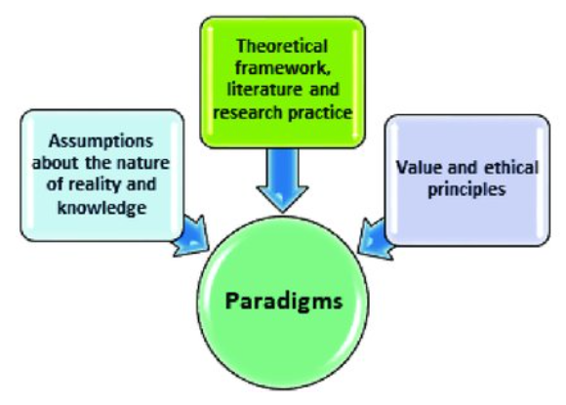

OO “Paradigm”
Philosophical/theoretical framework for theories, laws, generalizations
https://www.merriam-webster.com/dictionary/paradigm
Patterns of thought and sets of supporting information
Not this!
This!
https://www.researchgate.net/publication/335396216_Selection_of_Research_Paradigms_in_English_Language_Teaching_Personal_Reflections_and_Future_Directions

Slide 5
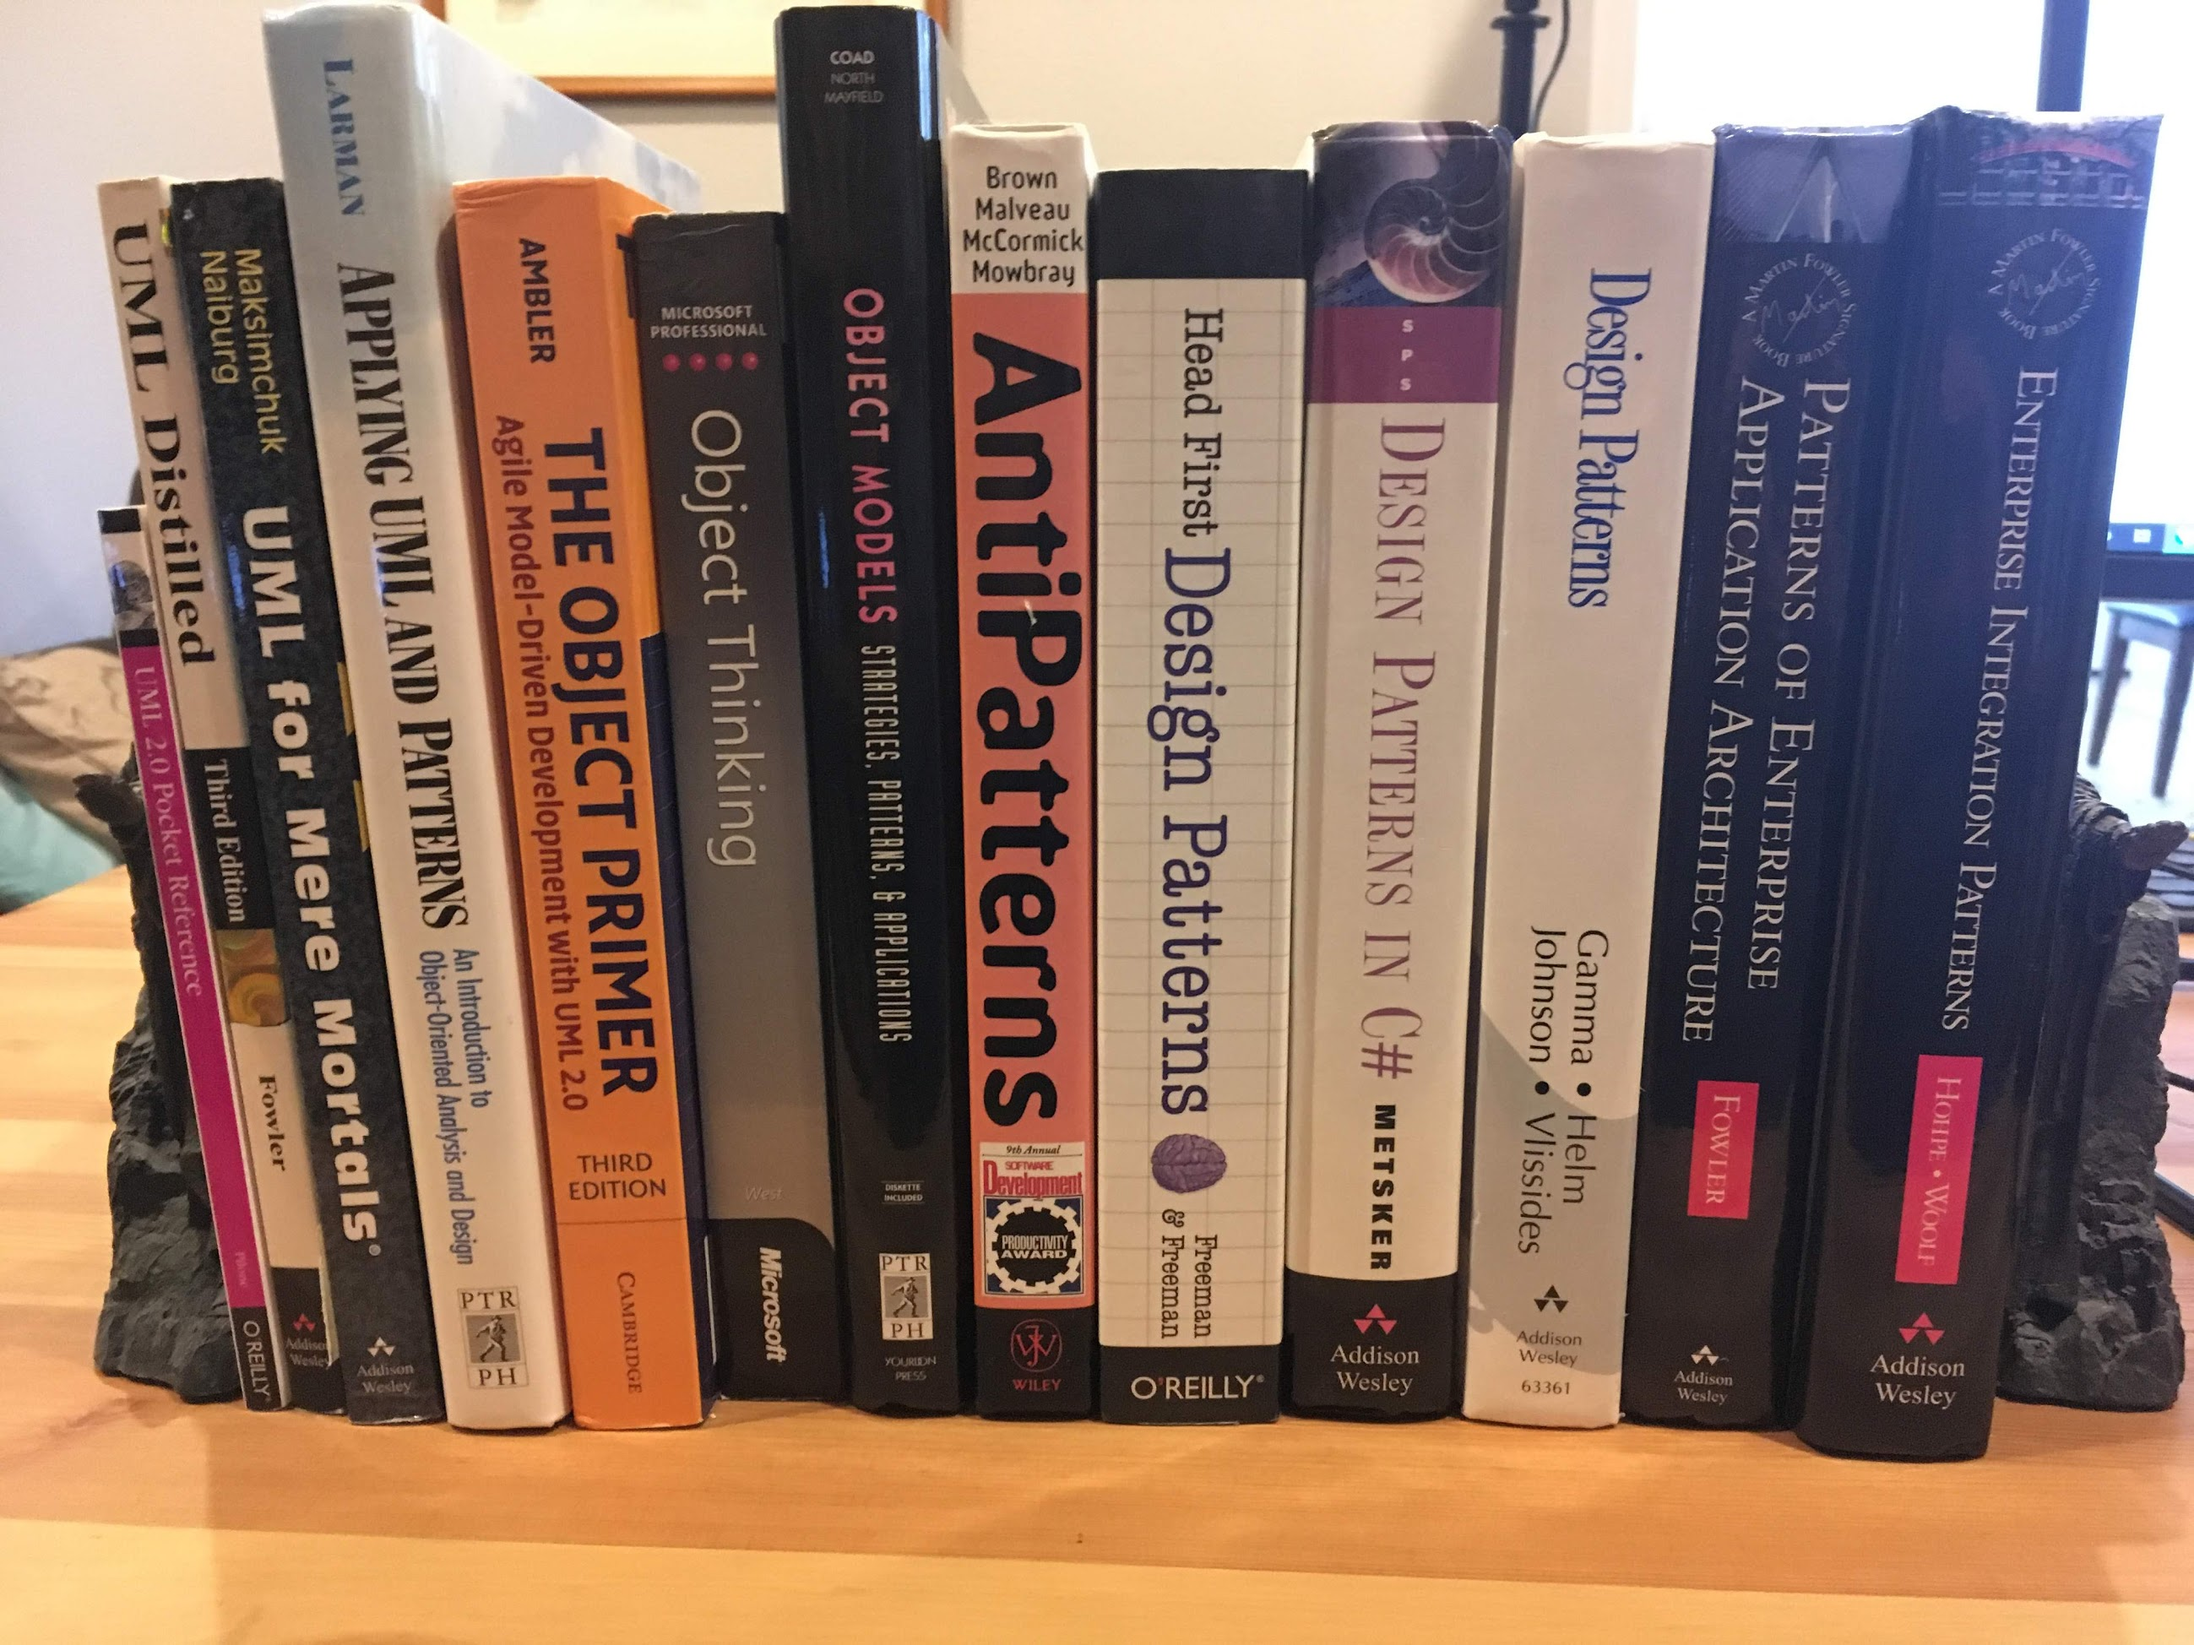
OO Resources
Chunk of my home book shelf for UML, Patterns, and OO topics
Design Patterns by Gamma, Helm, Johnson, and Vlissides is the famous “Gang of Four” book
Gamma and Helm met at OOPSLA 1990 considering an architecture handbook, Johnson and Vlissides joined for the initial book published in 1994

Slide 6
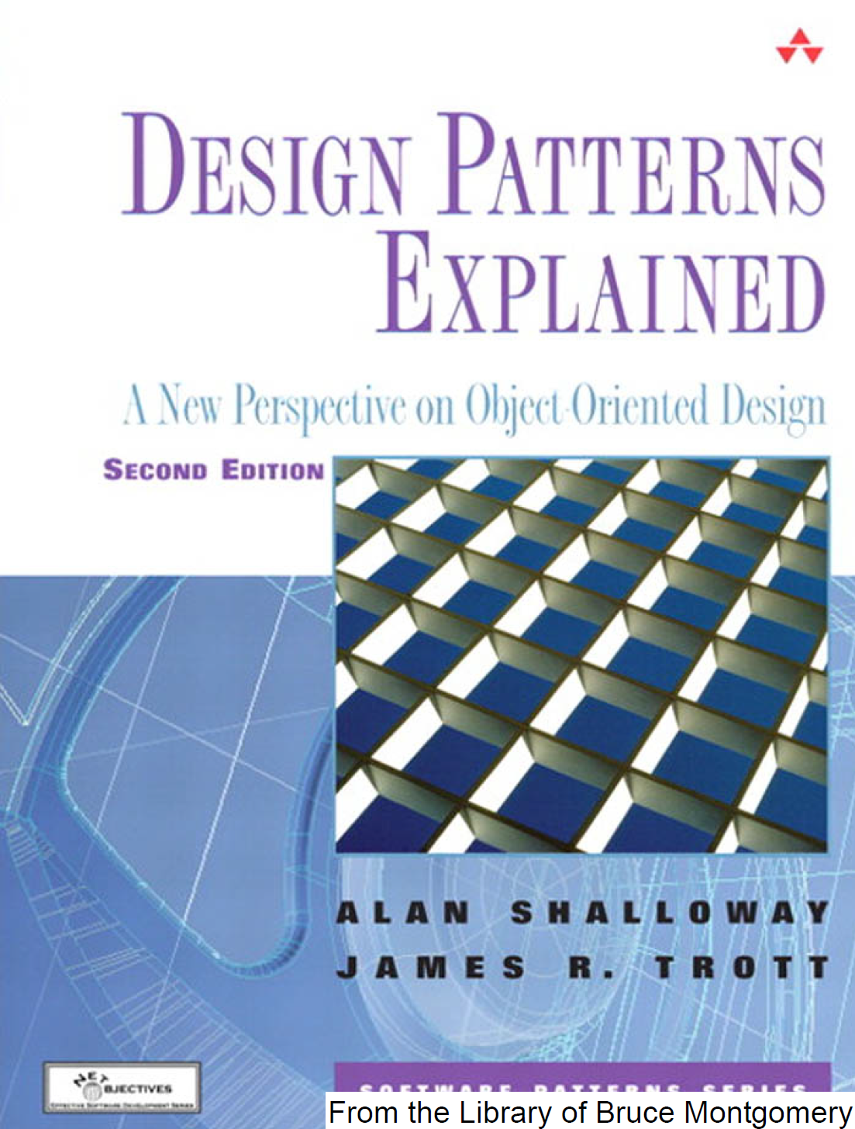
Prior Textbook
Design Patterns Explained
A New Perspective on Object-Oriented Design, Second Edition
Alan Shalloway and James R. Trott
Addison Wesley, © 2005
This was the textbook for some time
It’s a good book, and I will pull some examples from it, but we spend more time talking about examples from Head First Design Patterns, so I went there instead
If I reference this, I’ll call it “Shalloway/Trott”

Slide 7
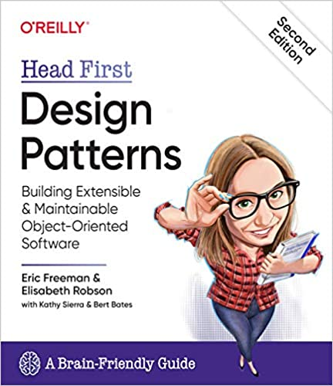
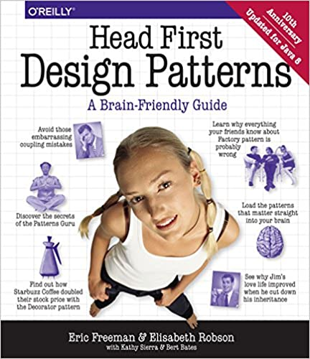
Our Textbook
Textbook:
Head First Design Patterns
Freeman, Robson, Bates, & Sierra
O’Reilly
2nd Edition (!), 2020
Last version was 10th Anniversary Edition - 2014 (updated for Java 8)
I will be visiting most of the content in this book, but maybe not in order
Great examples, clear ties to OO principles
Book was updated in 2014 to Java 8 examples (Java 8 is in LTS to March 2025)
2nd Edition is not a LOT different than 2014’s (exception – Observer)
“Cool” poster also available out there
I’ll call this “Head First”

Slide 8
What can you do? (Show of hands)
How many people are comfortable starting from scratch and creating:
a script?
a desktop application?
a web service?
a mobile application?
a system of systems? (i.e. desktop plus web service)
a database-backed application?
a cloud-based application?
IoT app on an SBC?
an embedded device?

Slide 9
Discussion
When you create a program from scratch:
do you use OO techniques?
OO design heuristics?
design patterns?
If not, what style of software design do you use?
What styles of software design are you aware of?

Slide 10
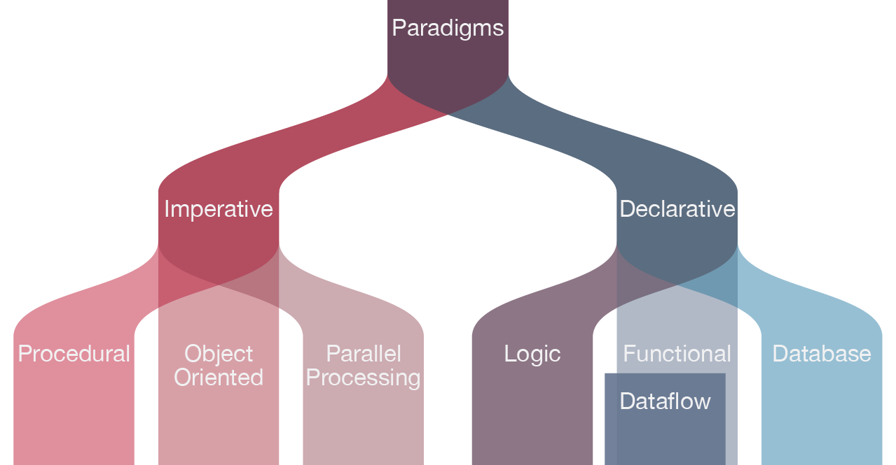
Design Methods
Ways of solving problems
Structured Design/ Programming (a.k.a. functional decomposition)
“Think in terms of steps”
Example languages – C, Pascal, FORTRAN
Object-Oriented Design/Programming
“Think in terms of objects that do things”
Example languages – C++, C#, Java, Python, Objective-C
Functional Programming (a.k.a. declarative programming)
“Think in terms of functions and their composition”
Example languages – Mathematica, Lisp, Erlang, F#
https://www.watelectronics.com/types-of-programming-languages-with-differences/

Slide 11
Simple Problem: Display Shapes
Functional decomposition: break problem into small steps
Connect to database
Locate and retrieve shapes
Sort the shapes (perhaps by z-order; draw background shapes first)
Loop through list and display each shape
Identify shape (circle, triangle, square?)
Get location of shape
Call function to display the shape at the given location

Slide 12
Functional Decomposition
Decompose big problems into the functional steps required to solve it
For a very big problem, simply break it down to smaller problems
then decompose smaller problems into functional steps
Goal is to slice up the problems until they are at a level of granularity that is easy to solve in a couple of steps
Then arrange the steps into an order that solves all of the identified subproblems and, presto, the big problem is solved along the way
Extremely natural approach to problem solving; we do this almost without thinking about it

Slide 13
Functional Decomposition: Problems
There are two main problems with this approach to design
It creates designs centered around a “main program”
This program is in control and knows all of the details about what needs to be done and all of the details about the program’s data structures
It creates designs that do not respond well to change requests
These programs are not well modularized and so a change request often requires modification of the main program; a minor change in a data structure, for example, might cause impacts throughout the entire main program

Slide 14
Why do these problems exist?
These problems occur with the functional decomposition approach because the resulting software exhibits
poor use of abstraction
poor encapsulation (a.k.a. information hiding)
poor modularity
If you have poor abstractions and you want to add another one, it’s often not clear how to do it (easily)
If you have poor encapsulation and poor modularity, changes tend to percolate through the code since nothing prevents dependencies from forming throughout the code

Slide 15
Why should we care?
Head First: One constant in software development: Change
Shallloway/Trott book:
“Many bugs originate with changes to the code”
and
“Things change. They always do. And nothing you can do will stop change [from occurring to your software system].”
We need to ensure that we do not get overcome by change requests; that we create designs that are resilient to change;
Indeed, we want software designs that are “designed” to accommodate change in a straightforward manner
That is what OO A&D provides!

Slide 16
“Functional Elegance”
OO development also supports us in providing software that is well designed and usable, for users and other developers
In his tutorials, Jacob Jenkov describes this as functional elegance, defined as:
“Solve my problem, with minimal effort from me, and don’t get in my way”
Elegance equates to “making something hard seem easy, almost effortless”
He provides a code example of summing the bytes in an array
In his “elegant” example, he provides a simple sum of the entire array, as well as a selected part of the array, all in the same code (using an overloaded sum method), resulting in a method that is both useable and useful
byte[] byteArray = ... // get byte array from somewhere
int sumAll = sum(byteArray);
int sumPart = sum(byteArray, 10, 20);
http://tutorials.jenkov.com/software-elegance/index.html
The Jenkov tutorials are a great place to review Java, by the way

Slide 17
Abstraction & Encapsulation
Simple Definitions
Abstraction refers to the set of concepts that some entity provides (or exposes) for achieving a task or solve a problem
Simple Example: the public methods of Java’s String class
Encapsulation refers to a set of language-level mechanisms or design techniques that hide implementation details of a class, module, or subsystem from other classes, modules, and subsystems
Simple Example: In most OO programming languages, marking an instance variable “private” ensures that other classes cannot access the value of that variable directly
They need to make use of a method in order to retrieve or update that particular internal variable

Slide 18
Design…
Let’s transition back to design methods
Discussion of Analysis and Requirements
Additional Problems with Functional Decomposition
Cohesion and Coupling
The OO Approach

Slide 19
Analysis and Requirements
Analysis is the phase of software development that occurs
before design when starting from scratch
that occurs first when responding to a change request during the maintenance of an existing system
Its primary goal is to answer the following question
What is the problem that needs to be solved?
Design is the phase that comes after analysis and its goal is:
How am I going to solve the problem?
Requirements for a software system are initially generated during the analysis phase of software development and are, typically:
Functional
“the system should allow its users to sort records by priority”
Non-functional
“the system should support 10,000 simultaneous users”
Constraints
“the system will comply with regulation XYZ at all times”

Slide 20
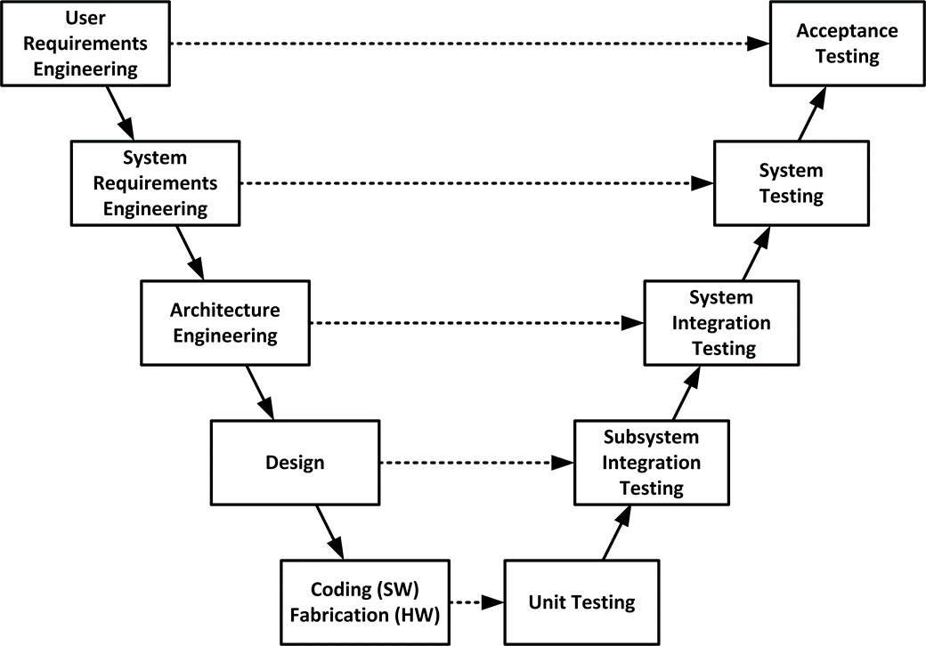
Levels of Requirements (“The V”)
Progressive elaboration…
Deeper levels of design requirements for more discrete elements of the application
Best Practices for Requirements
Specific and distinct requirements
Complete and well thought out
Consistent and prioritized based on the objectives
Able to be verified during testing
A road of good intentions…
https://insights.sei.cmu.edu/sei_blog/2013/11/using-v-models-for-testing.html

Slide 21
The Problem of Requirements (I)
The problem? Experienced developers will tell you that
It can be hard to elicit requirements
Requirements are incomplete and do not tell the whole story
Requirements are often wrong
factually wrong or become obsolete
Requirements and users are misleading
In addition, users may be non-technical and may not understand the range of options that could solve their problem
their ill-informed suggestions may artificially constrain the space of solutions

Slide 22
The Problem of Requirements (II)
The other problem with requirements is
“requirements always change”
They change because
a user’s needs (or the product) may change over time
as they learn more about a new problem domain, a developer’s ability to generate better solutions to the original problem (or the current problem if it has evolved) will increase
the system’s environment changes
new hardware, new external pressures, new techniques

Slide 23
The Problem of Requirements (III)
Many developers view changing requirements as a bad thing
and few design their systems to be resilient in the face of change
Luckily, this view is changing
agile software methods tell developers to welcome change
they recommend a set of techniques, technologies and practices for developers to follow to remove the fear of change
OO analysis, design and programming techniques provide you with powerful tools to handle change to software systems in a straightforward manner

Slide 24
The Problem of Requirements (IV)
However, this does not mean that we stop writing requirements
They are incredibly useful despite these problems
The lesson here is that we need to improve the way we design our systems and design our code such to allow change to be managed
Agile methods make use of “user stories”; other life cycle methods make use of requirements documents or use cases (scenarios that describe desired functional characteristics of the system)
Once we have these things, and the understanding of the problem domain that they convey, we then have to design our system to address the requirements while leaving room for the requirements to change

Slide 25
The Problem with Functional Decomposition
A common problem with code developed with functional decomposition
weak cohesion and tight coupling
translation: “it does too many things and has too many dependencies”
Example
void process_records(records: record_list) {
// sort records, update values in records, print records, archive records and log each operation as it is performed …
}

Slide 26
Cohesion
Code Complete 2 by Steve McConnell; Microsoft Press, 2004
Cohesion refers to “how closely the operations in a routine are related”
A simplification is to say “we want this method to do just one thing” or “we want this module to deal with just one thing”
We want our code to exhibit strong cohesion (a.k.a. highly cohesive)
methods: the method performs one operation
classes: the class achieves a fine-grain design or implementation goal
packages: the package achieves a medium-grain design goal
subsystems: this subsystem achieves a coarse-grain design goal
system: the system achieves all design goals and meets its requirements

Slide 27
Coupling
Code Complete 2 by Steve McConnell; Microsoft Press, 2004
Coupling refers to “the strength of a connection between two routines”
It is a complement to cohesion
weak cohesion implies strong coupling
strong cohesion implies loose coupling
With strong or tight coupling, a single change in one method or data structure will cause ripple effects, that is, additional changes in other parts of the system – often unwanted side effects from change
We want systems with parts that are highly cohesive and loosely coupled

Slide 28
Transitioning to the OO Paradigm
Rather than having a main program do everything
populate your system with objects that can do things for themselves
Scenario: You are an instructor at a conference. Your session is over and now conference attendees need to go to their next session
With functional decomposition, you would develop a program to solve this problem that would have you the instructor do everything
Get the roster, loop through each attendee, look up their next session, find its location, generate a route, and, finally, tell the attendee how to get to their next class
You would do everything, attendees would do (almost) nothing

Slide 29
Transitioning to the OO Paradigm
Would you do this in real life?
And the answer is (hopefully) NO!
What would you do instead?
You would assume that everyone has a conference program, knows where they need to be next, and will get there on their own
All you would do is end the session and head off to your next activity
At worst, you would have a list of the next sessions at the front of the class and you would tell everyone “use this info to locate your next session”

Slide 30
Compare / Contrast
In the first scenario (functional decomposition),
you know everything, you are responsible for everything, if something changes you would be responsible for handling it
you give very explicit instructions to each entity in the system
In the second scenario (object-oriented),
you expect the other entities to be self sufficient
you give very general instructions and
you expect the other entities to know how to apply those general instructions to their specific situation
it will be easier to add special cases by adding other independent entities
OO shifts responsibility away from a central control program to the entities themselves

Slide 31
Foreshadowing
The benefits we’ve been discussing are inherent in the OO approach to analysis, design and implementation that we will be learning this entire semester
self-sufficient entities ➡ objects
“give general instructions to” ➡ code to an interface
“expect entities to apply those general instructions to their specific situation” ➡ polymorphism and subclasses
“add new attendees without impacting session leader” ➡ code to an interface, polymorphism, subclasses
shift of responsibility ➡ functionality distributed across network of objects

Slide 32
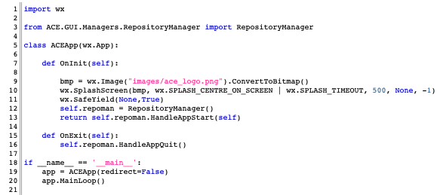
As an aside...
OO main programs tend to be short
On the order of create an object and send a message to it
Create an object
Send a message to it

Slide 33
The Object-Oriented Paradigm
OO Analysis & Design is centered around the concept of an object
It produces systems that are networks of objects collaborating to fulfill the responsibilities (requirements) of the system
Objects are conceptual units that combine both data and behavior
The data of an object is referred to by many names
attributes, properties, instance variables, etc.
The behavior of an object is defined by its set of methods
Methods and attributes are members of an object (or class)
Objects inherently know what type they are.
Its attributes allows it to keep track of its state.
Its methods allow it to function properly.
a.k.a. features
Return to Slide 41

Slide 34
Object Responsibilities
In OO Analysis and Design, it is best to think of an object as “something with responsibilities”
As you perform analysis (What’s the problem?), you discover responsibilities that the system must fulfill
You will eventually find “homes” for these responsibilities in the objects you design for the system; indeed this process can help you “discover” objects needed for the system
The problem domain will also provide many candidate objects to include in the system
This is an example of moving from a conceptual perspective to the specification and implementation perspectives

Slide 35
Objects and Design Perspectives
Conceptual — a set of responsibilities
Specification — a set of methods
Implementation — a set of code and data
Unfortunately, OO A&D is often taught only at the implementation level
if previously you have used OO programming languages without doing analysis and design up front, then you’ve been operating only at the implementation level
“jumping into code”
as you will see, there are great benefits from starting with the other levels first

Slide 36
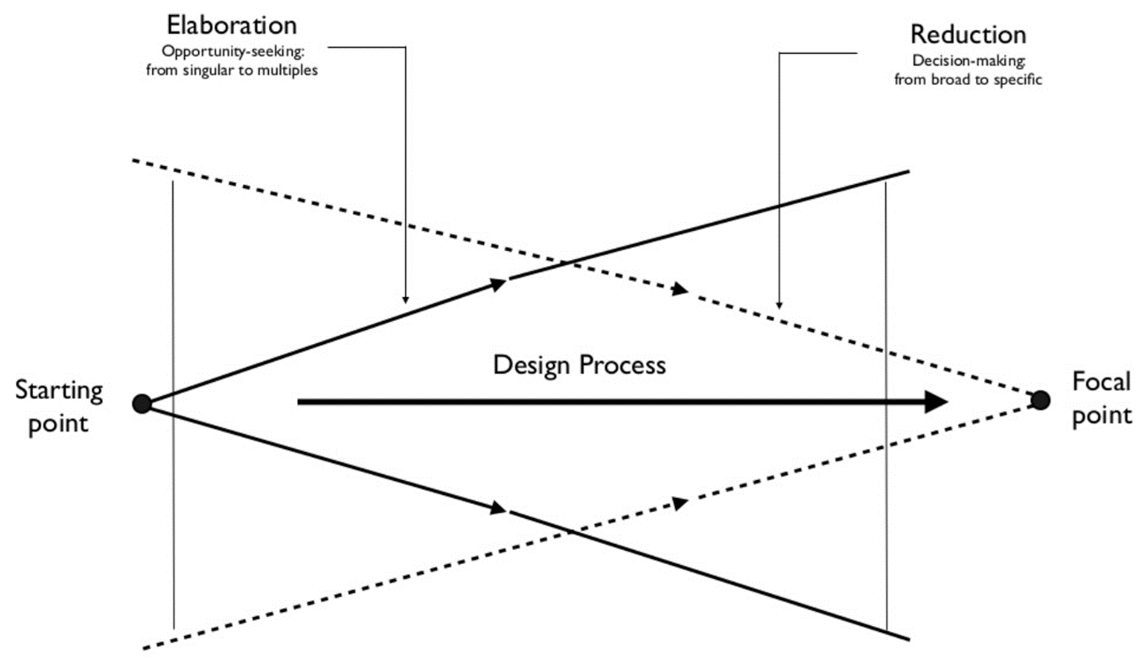
Benefits of Thinking Conceptually
Broad thinking in the early phases of Progressive Elaboration on a design
Avoidance of Premature Optimization away from possible design choices
In Object terms – focusing on responsibilities of the system and its elements
Envisioning this – Bill Buxton’s Design Funnel
From Sketching User Experiences, Buxton, 2007, Morgan Kaufmann
Aside: Sketching (defined broadly) is a great way to explore many different ideas quickly…

Slide 37
Objects as Instances of a Class
If you have two Student objects, they each have their own data
e.g. Student A has a different set of values for its attributes than Student B
But they both have the same set of methods
This is true because methods are associated with a class that acts as a blueprint for creating new objects
We say “Objects are instances of a class”
Classes define the complete behavior of their associated objects
what data elements and methods they have and how these features are accessed (whether they are public or private)

Slide 38
Classes, Subclasses, Superclasses
The most important thing about a class is that it defines a type with a legal set of values
Consider these four types
Complex Numbers ➡ Real Numbers ➡ Integers ➡ Natural Numbers
Complex numbers is a class that includes all numbers; real numbers are a subtype of complex numbers and integers are a subtype of reals, etc.
in each case, moving to a subtype reduces the set of legal values
The same thing is true for classes; A class defines a type and subclasses can be defined that excludes some of the values from the superclass

Slide 39
Class Inheritance
Classes can exhibit inheritance relationships
Behaviors and data associated with a superclass are passed down to instances of a subclass
The subclass can add new behaviors and new data that are specific to it; it can also alter behaviors that are inherited from the superclass to take into account its own specific situation – making it a derived class
It is extremely desirable that any property that is true of a superclass is true of a subclass; the reverse is not true: it is okay for properties that are true of a subclass not to be true of values in the superclass
For instance, the property isPositive() is true for all natural numbers but is certainly not true of all integers

Slide 40
Superclass/Subclass Inheritance Relationships
Inheritance relationships are known as is-a relationships
Undergraduate IS-A Student (i.e. Undergraduate is-a subclass of Student)
This phrase is meant to reinforce the concept that the subclass represents a more refined, more specific version of the superclass
If need be, we can treat the subclass as if it IS the superclass.
It has all the same attributes and all the same methods as the superclass
so code that was built to process the superclass can equally apply to the subclass

Slide 41
Class Encapsulation
Classes can control the accessibility of the features of their objects
That is they can typically specify whether an attribute or method has an accessibility of public, protected, or private.
This ability to hide features of a class/module is referred to as encapsulation or information hiding;
however, encapsulation is a topic that is broader than just data hiding, as we will discuss later in the semester

Slide 42
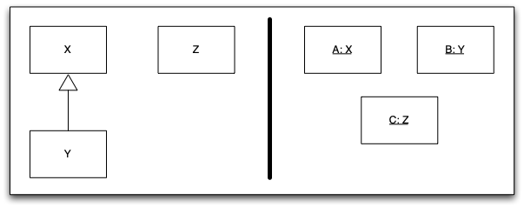
Accessibility, continued
Object A is an instance of class X
Object B is an instance of class Y which is a subclass of X;
Object C is an instance of class Z which is unrelated to X and Y
Hey, that’s a UML Model!

Slide 43
Accessibility, continued
Public visibility of a feature of class X means that A, B and C can access that feature
Protected visibility of a feature of class X means that A and B can access the feature but C cannot.
Private visibility of a feature of class X means that only A can access the feature
Note: these are the general definitions; different programming languages implement these accessibility modifiers in different ways
Consult the documentation for details specific to your favorite OO programming language

Slide 44
Class Constructors/Destructors
Classes can control how their objects are created and destroyed
OO Programming languages will (typically) provide “special methods” known as constructors and destructors (a.k.a. finalizers) to handle these two phases in an object’s life cycle
Constructors are useful for ensuring that an object is properly initialized before any other object makes use of it
Destructors are useful for ensuring that an object has released all of the resources it consumed while it was active
Destructors can be tricky; in languages with garbage collection, an inactive object might hang around for a significant amount of time before the garbage collector gets around to reclaiming its space

Slide 45
One benefit of superclasses
Treat all instances of a superclass-subclass hierarchy as if they were all instances of the superclass even if some are instances of subclasses
Example
Suppose we have the classes, Undergraduate, MastersStudent and PhDStudent in a software system
Problem: We may have a need for acting on all instances of these three classes at once, for instance, storing them all in a collection, sorting by last name and displaying a roster of the entire university
Solution: Make all three of these classes a subclass of the class Student; You can then add all of the students to a single collection and treat them all the same

Slide 46
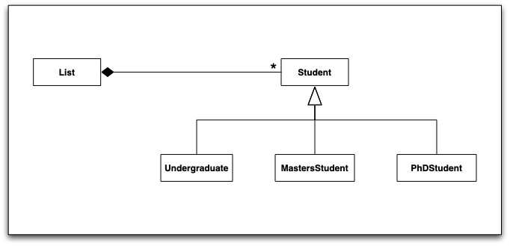
Example rendered in UML
Note: UML Notation will be discussed in further lectures

Slide 47
Another benefit of superclasses
Not only can you group all instances of an object hierarchy into a single collection, but you can apply the same operations to all of them as well
In our example, any method defined in the superclass, Student, can be applied to all instances contained in our collection (the List of Students)
On the following slide:
Student has a method called saySomething() which is overridden by each subclass to say something different
Yet look how clean the code is…

Slide 48
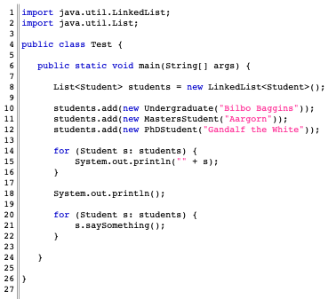

Slide 49
The True Power: Clean Code!
The most powerful code in the previous example was
Why?
You can add as many subclasses to the Student hierarchy as you want and this code never has to change!
It doesn’t even have to be recompiled (demo)
Indeed, given the right techniques, a server running this code doesn’t even need to be “brought down”; the new subclass can be dynamically loaded and this code will recognize instances of that subclass and do the right thing
for (Student s: students) {
s.saySomething();
}

Slide 50
Polymorphism
The previous example demonstrated polymorphism
which literally means “many forms”
in OO A&D it means that we can treat objects as if they were instances of an abstract class but get the behavior that is required for their specific subclass
The “many forms” refers to the many different behaviors we get as we operate on a collection of objects that are instances of subclasses of a generic, abstract class
In Shalloway/Trott, polymorphism is defined specifically as
“Being able to refer to different derivations of a class in the same way, but getting the behavior appropriate to the derived class being referred to”
Awkward definition… maybe:
“Ability of related objects to implement methods specialized to their type”
We will see many examples of polymorphism as we move forward in the semester and you will get a chance to try it out for yourself

Slide 51
Abstract Classes
The classes that sit at the top of an object hierarchy are typically abstract classes while the classes that sit near the bottom of the hierarchy are called concrete classes
Abstract classes
define a set of generic behaviors for a related set of subclasses;
act as placeholders for other classes defining method signatures that they must implement, defining method bodies for behaviors that should be the same across all subclasses, defining data that will be useful for all subclasses
In OO programming languages, abstract classes cannot be instantiated
instead you instantiate concrete classes but access them via the interface defined by the abstract class

Slide 52
Summary
In this lecture, we have touched on a variety of OO concepts
Functional Decomposition vs. the OO Paradigm
Requirements and Change in Software Development
Design perspectives: Conceptual, Specification, Implementation
Be comfortable with the OO concepts and terminology
Coupling and Cohesion
Classes and Objects
Constructors, Destructors
Abstract, Derived, and Concrete Classes, Sub- and Super-class
Instance, Instantiation
Member, Attributes, Methods
Encapsulation
Inheritance
Polymorphism

Slide 53
Using the Head First Textbook
The Head First textbook really supports the details for the pattern lectures
You can probably manage to get through the class without using the textbook, as I steal from it quite a bit for my lectures
The benefits of the book
More complete code examples
Alternate explanations and discussions of topics
Reading the chapters before or after the topic lecture is a good practice to give you a complete perspective
I’ll give you a heads up in the lecture Next Steps about readings you should consider
Book chapters for lectures:
Design Patterns – Ch.1
Observer – Ch.2
Decorator – Ch.3
Factory – Ch.4
Singleton – Ch.5
Command – Ch.6
Façade/Adapter – Ch.7
Template – Ch.8
Iterator/Composite – Ch.9
MVC – Ch.12
State – Ch.10
Proxy – Ch.11
Ch.13 & Appendix A supports lectures on Bridge/Builder, Flyweight/Interpreter/Chain of Responsibility, Mediator/Memento, Prototype/Visitor

Slide 54
Next Steps
We will start office hours for all staff next week:
Office hours are posted in Canvas Announcements and Piazza posts
Latest
Finishing up office hours for the staff now, announcement soon
All class assignments and dates are loaded on Canvas
Examples of graduate and semester projects posted…
Assignments
The first participation discussion topic is up on Piazza, please respond – don’t get behind on these – try to respond every week! It is 100 points of your grade…
Project 1 is up on Canvas – individual work!
Part 1 (essay questions) is due in a week – Wed 8/31
Part 2 (code submission) is due in two weeks – Wed 9/7
We’ll talk about Project 2, the first team programming project on Wed 9/7
The first Quiz – based on lectures – will go up Sat by noon, due Thur 9/1
We’ll review the first part of the Graduate Research Project on Friday this week
Stay Engaged
Make sure you sign up for Piazza and Canvas notifications
Make sure you can access the Head First Design Patterns textbook – no readings yet
Consider tutorials/resources for Git and Java especially, if you need them
Coming up
Next up: More OO fundamentals, Tools – Java, Git/Markdown/Github, UML, Python
Please come find us for any help you need or questions you have!

